Slide 1
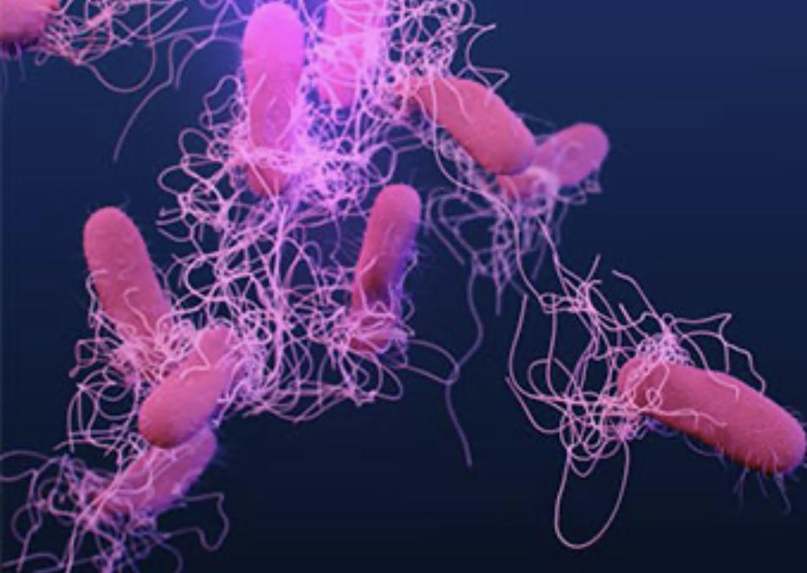
You Are What You Eat,
Unless What You Eat Kills You!
Javeshnev Aimee Rivera-Azua
STEAM Coach/Coordinator
School District of Palm Beach
javeshnev.azua@gmail.com
javeshnev.riveraazua@palmbeachschools.org

Slide 2
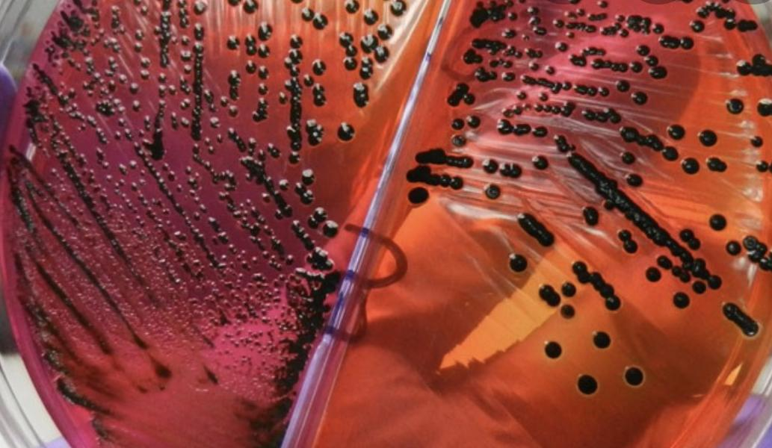
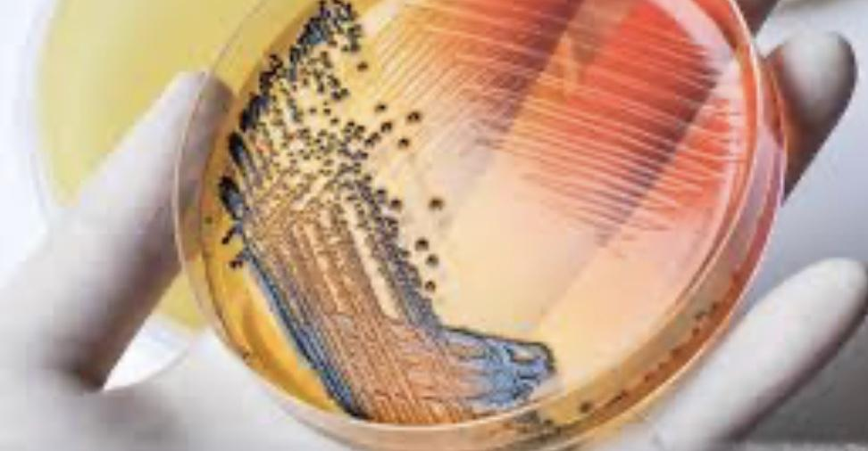
The Pathogen Simulation
Challenge
The Module simulates the process of diagnosing a Patient that has become afflicted with a pathogen
Role: as the Infectious Disease Clinician you will be using various strategies to diagnose the pathogen
Diagnostic Pathogen Tests used
Vibrio Salmonellae Rapid-Kit Test
DNA Microarray Test
Genetic Sequencing Analysis for Antibiotic Resistant Strain
Antibiotic Resistance and Medication Compatibility Analysis

Slide 3
Focus Rationale
targets the process of genetic variation that affects the evolution of pathogens and has led to antibiotic resistant strains that require compatibility assessments
to expose our students to the variability of treating pathogens depending on type and antibiotic resistance of the pathogen

Slide 4
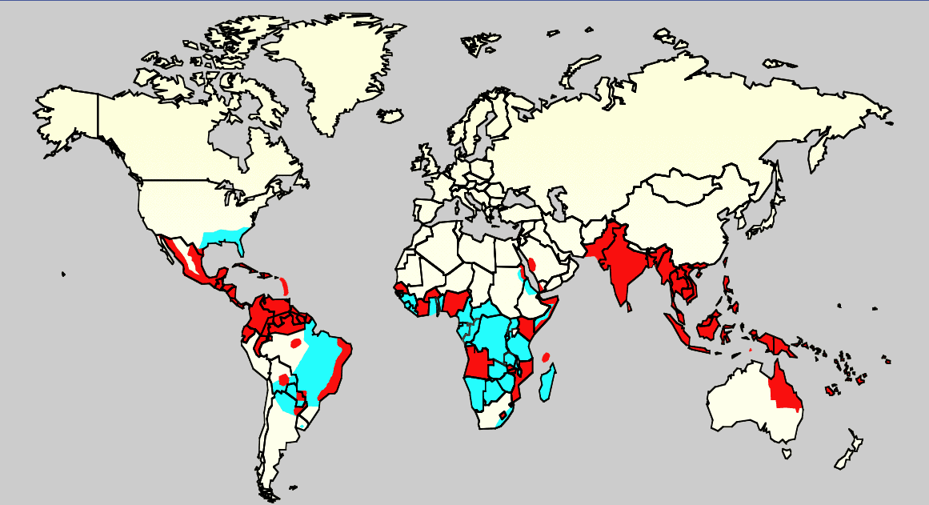
Salmonella Outbreak Epidemic Case

Slide 5
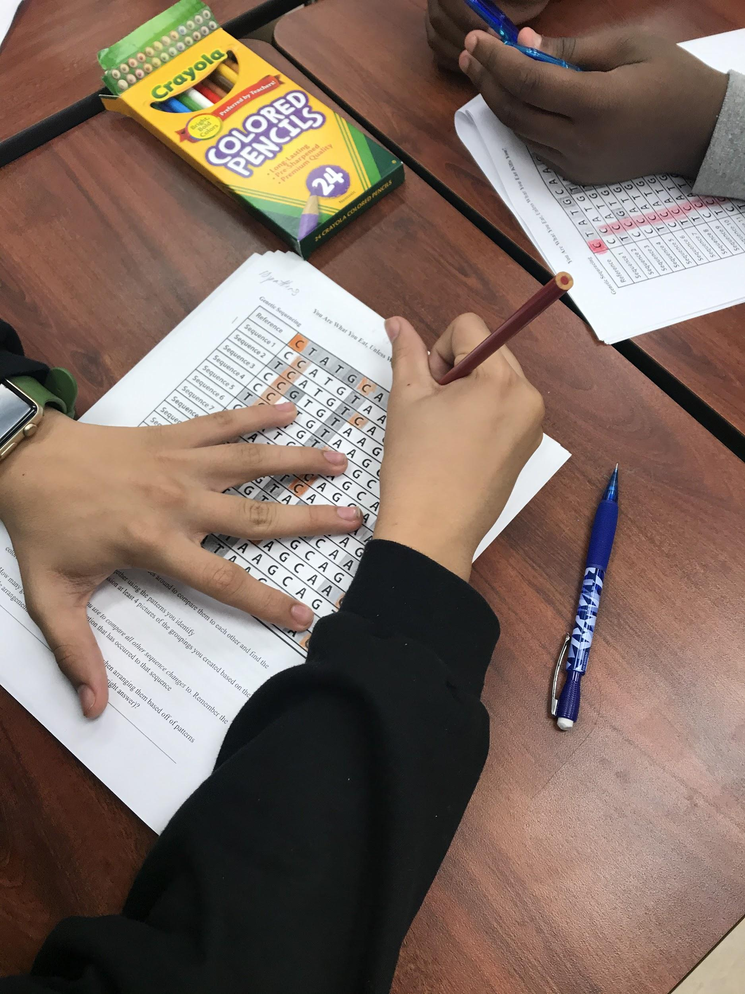
Targeted Audience
Targeted Students
8th Grade
9th-12th
College Level Undergraduate Students

Slide 6
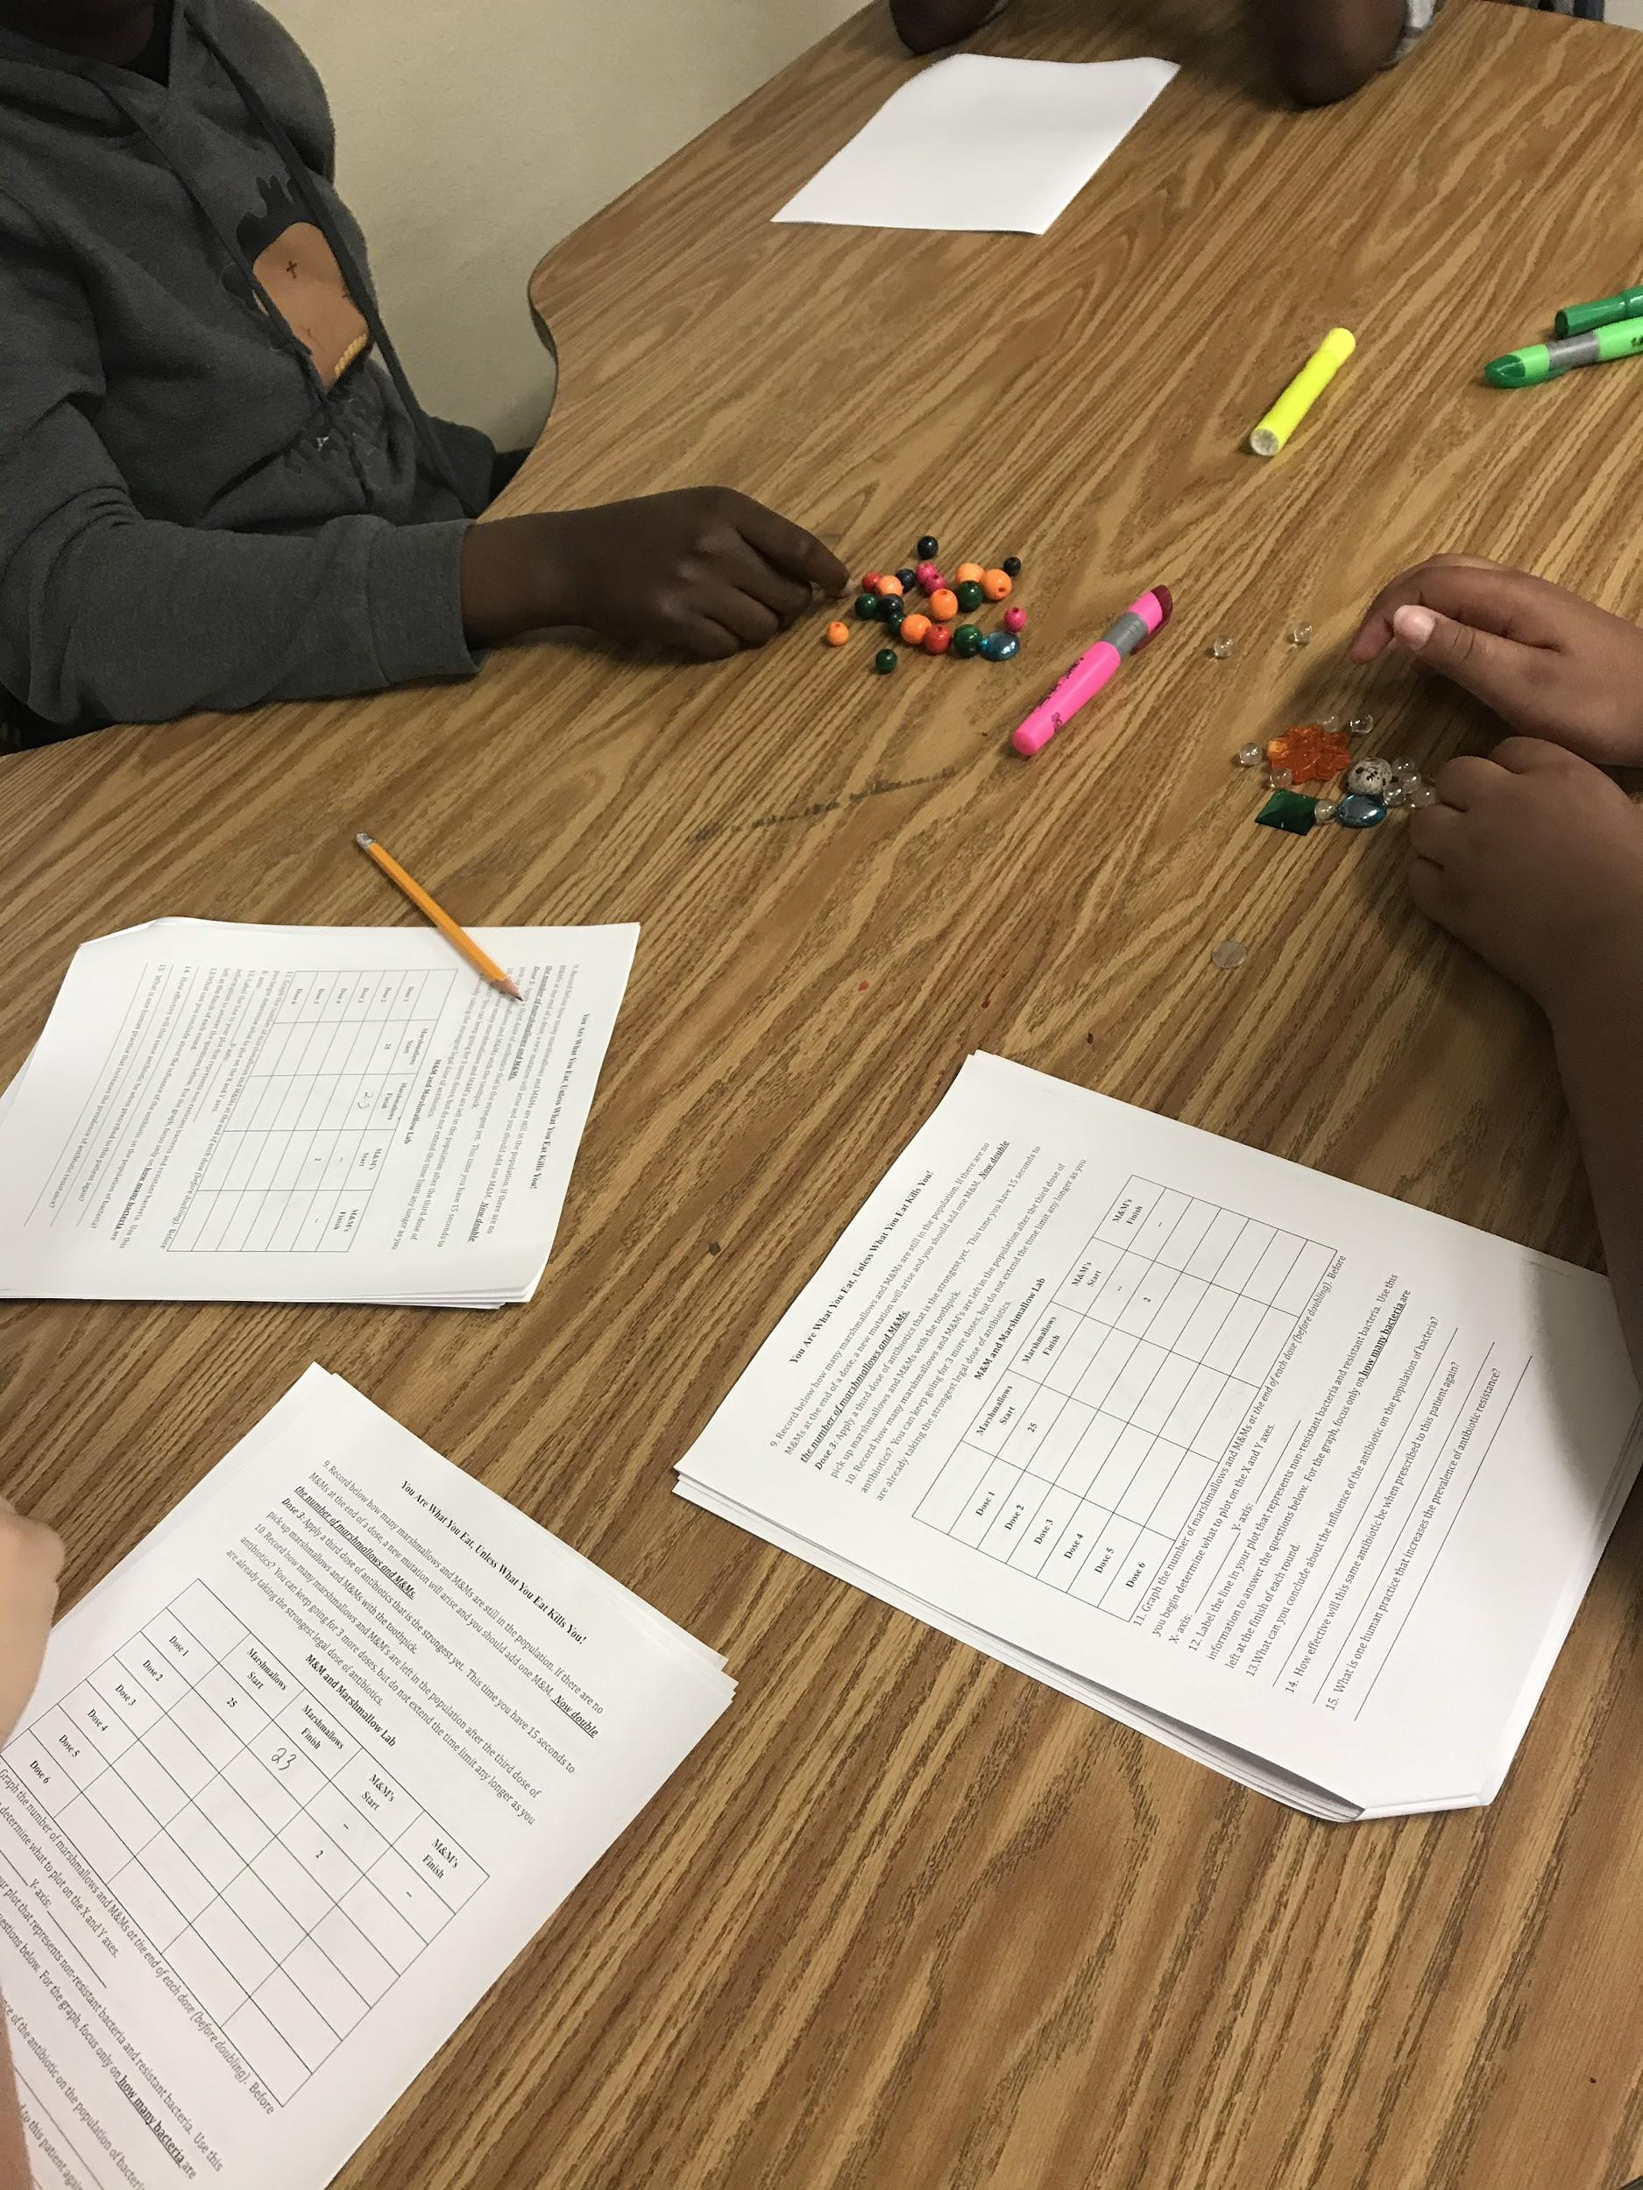
Implementation Process
Targeted Students
8th Grade / 9th-12th
Hands-on PBL facilitates lab
Required APA Lab
College Level Undergraduate Students
Blended learning model
Virtual Lab
Required APA

Slide 7
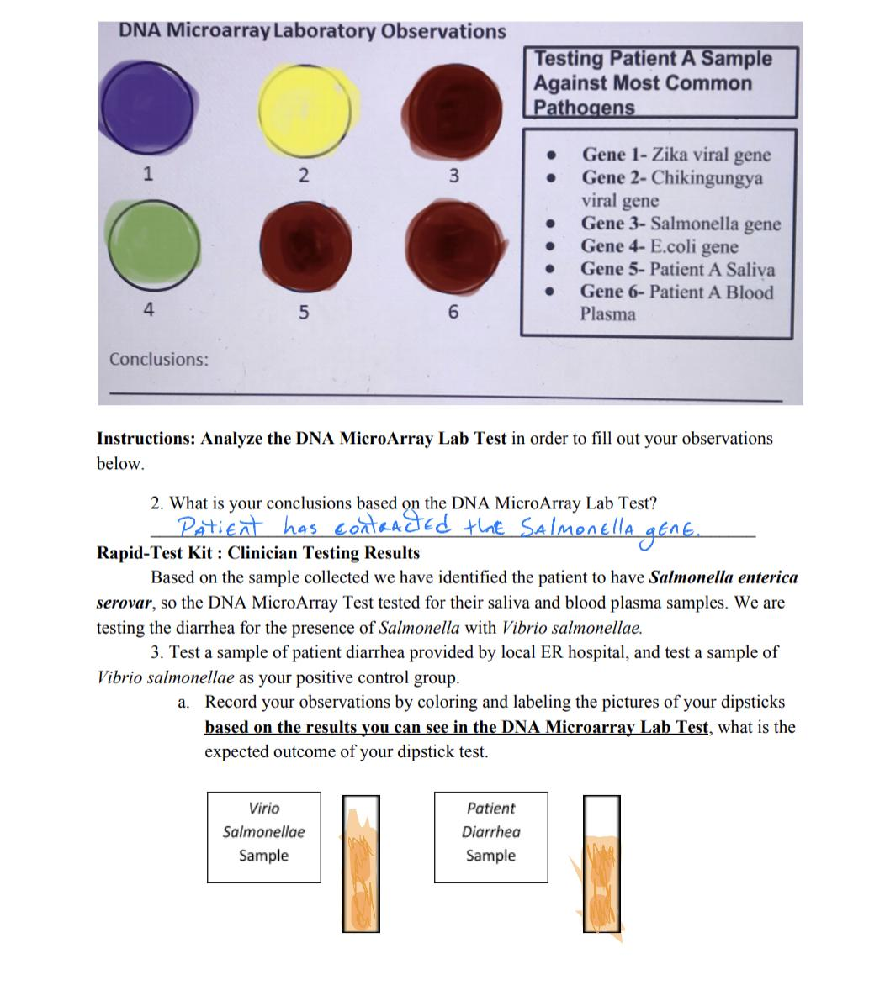
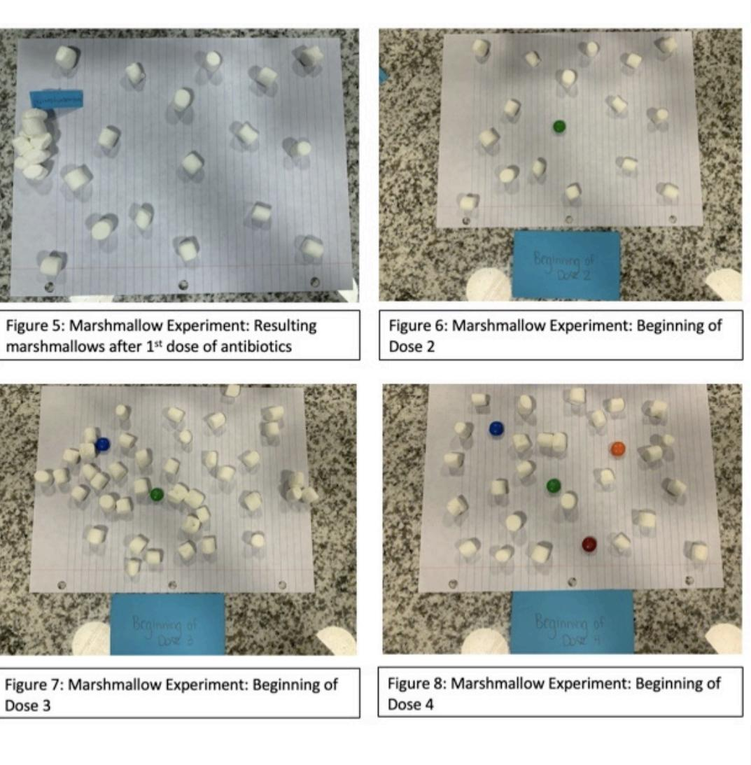

Slide 8
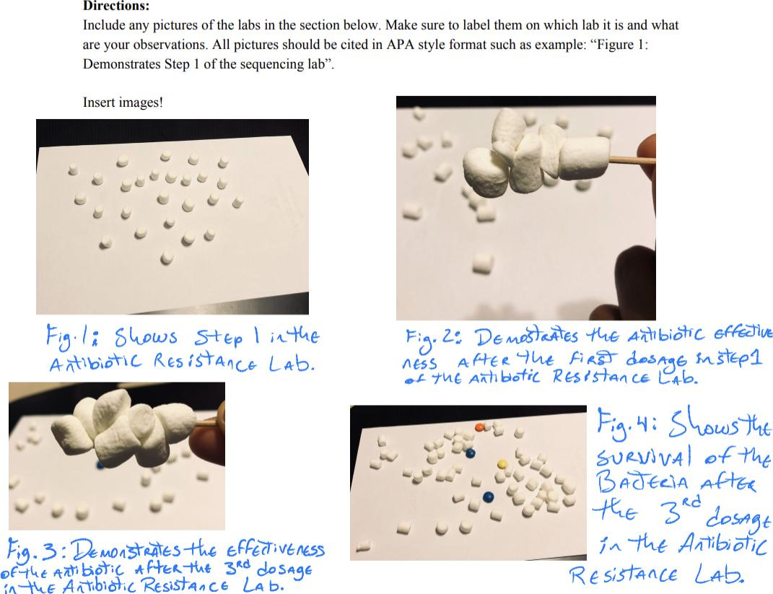
Marshmallow (Non-Resistant Strain Bacteria)
&
M&M (Resistant Strain Bacteria ) Lab

Slide 9
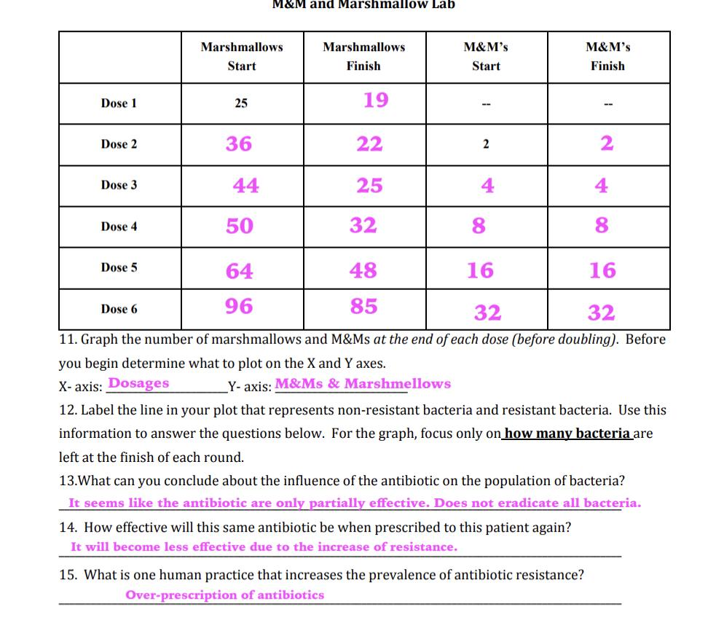

Slide 10
Genetic Sequencing

Slide 11
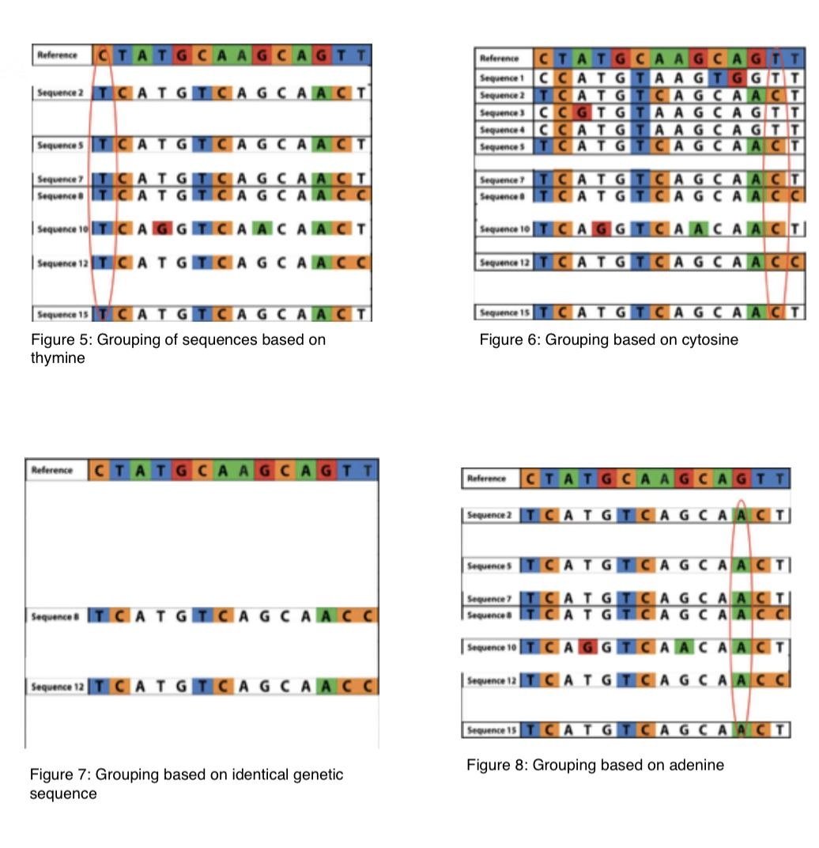
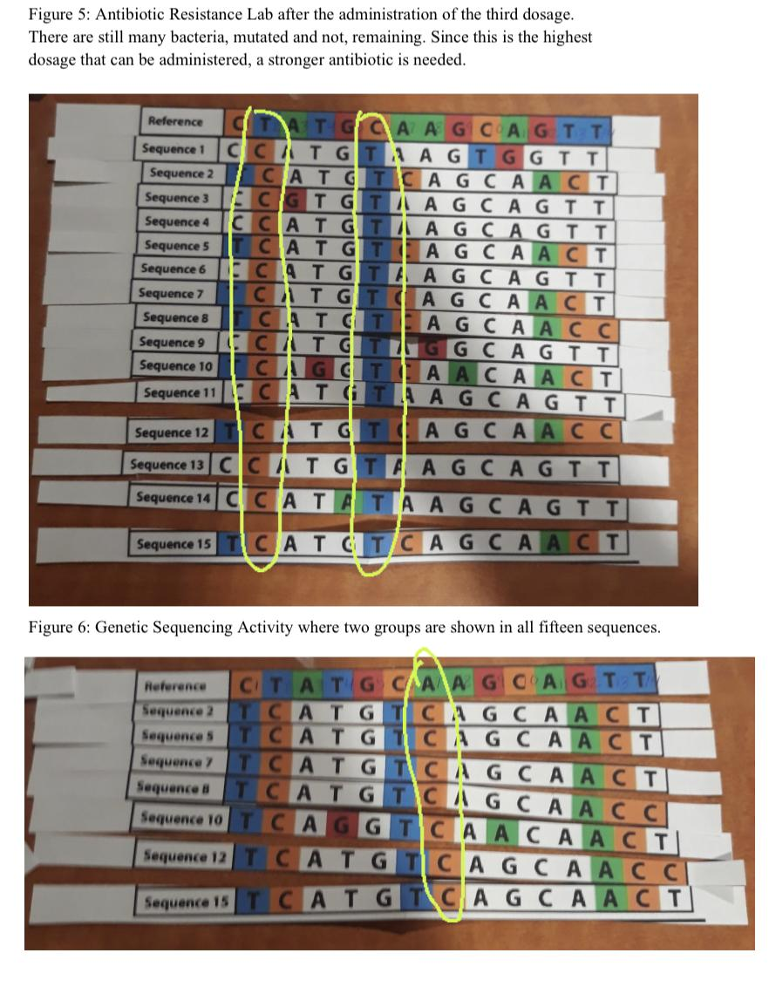

Slide 12
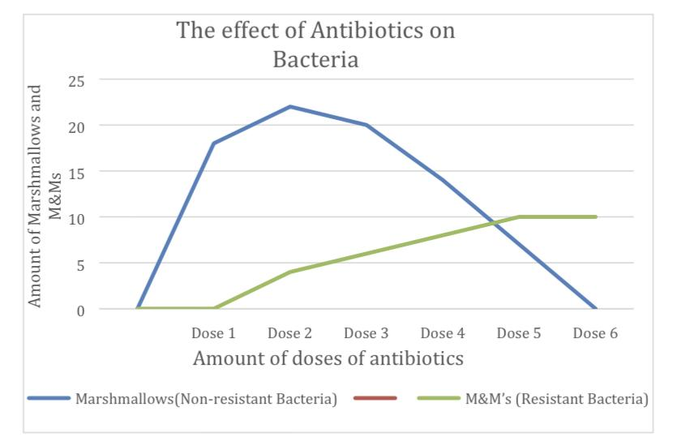
Graphing Results

Slide 13
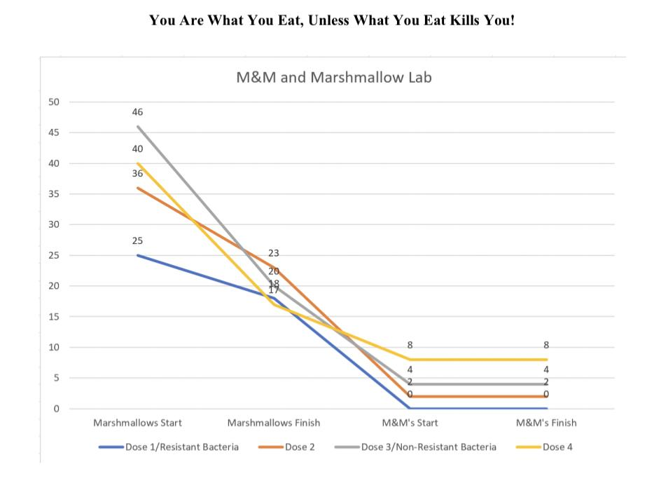
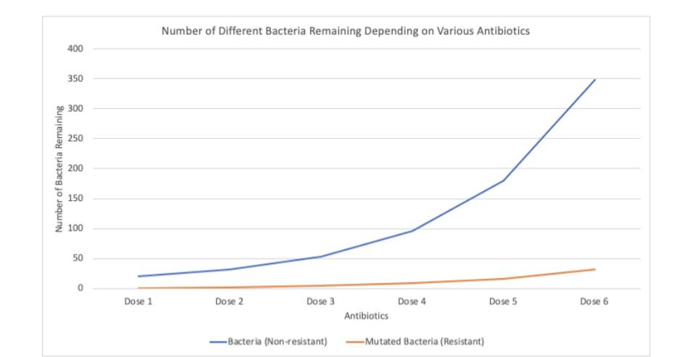
Errors in Graphing

Slide 14
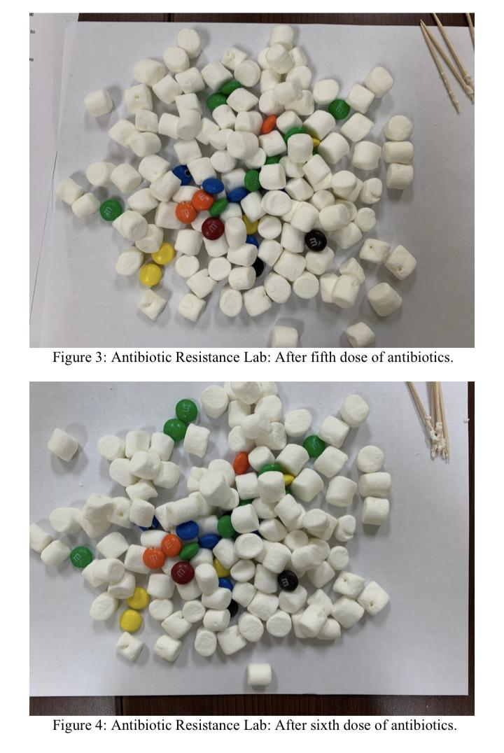
Suggested Changes & Clarifications
Clarify that you start with 25 marshmallows and will only be removing from not adding to during each dose
Clarify that m&m represents antibiotic resistant strain of bacteria;hard shell is the mutation that makes it more resistant to piercing toothpick (white blood cells/antibodies
Clarify type of graph is a line graph due to continuous time
Clarify /model how to find patterns in genetic sequences
Can be used as remediation for chapters, can be also used as a reading & ELA reading strategies activity as well

Slide 15
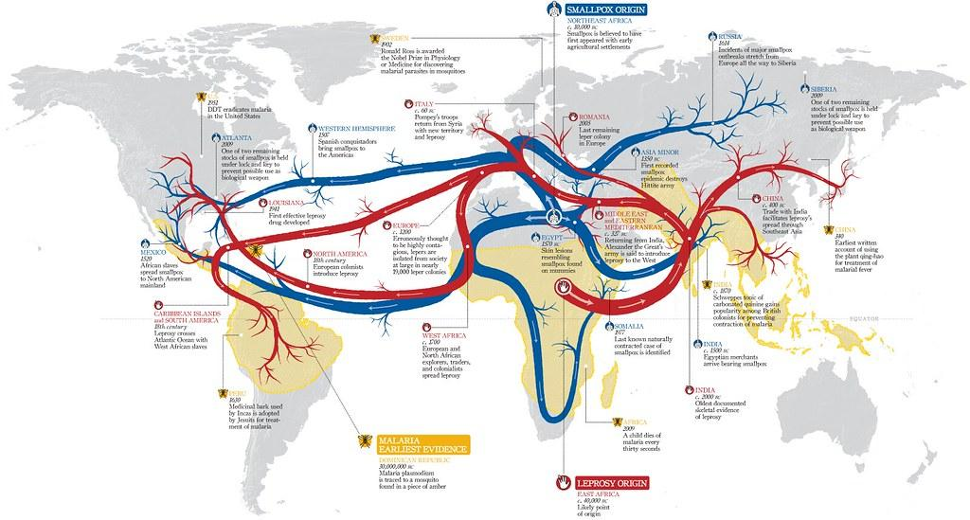
References

